Slide 1
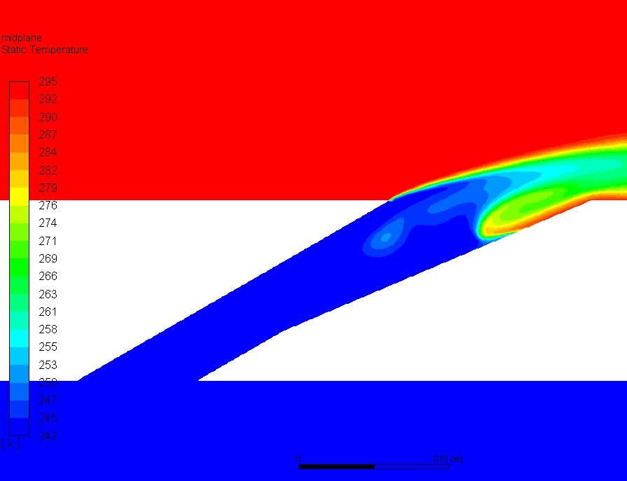
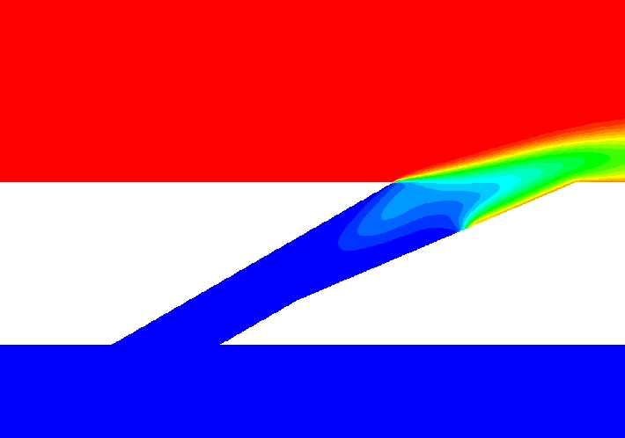
k-ω SST predicts really weird ingestion compared to Realizable k-ε
k-ω SST
Realizable k-ε
k-ω SST has some really strange ingestion that’s poorly diffused and really coherent. Temperature near the wall at the centerline of the film cooling hole is basically mainstream while Realizable k-ε shows a much more realistic mixing

Slide 2
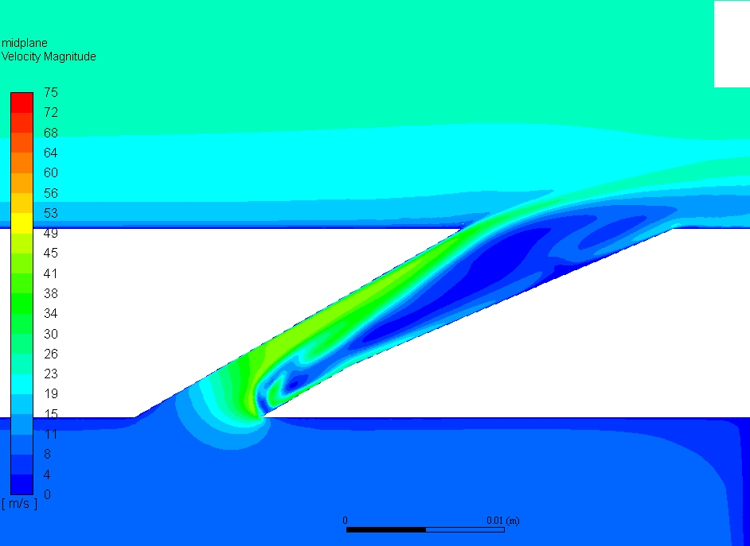
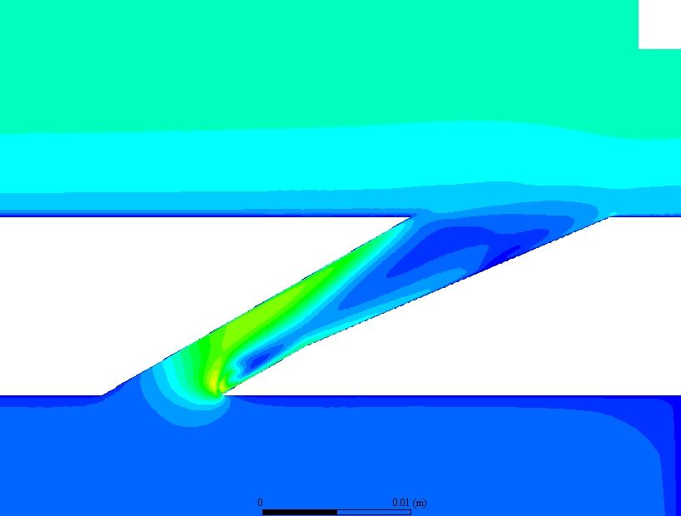
k-ω SST shows more coherency in the coolant Jet with a strange separation region
k-ω SST
Realizable k-ε
k-ω SST handles the separation behavior within the hole strangely. Without data I can’t really say whether one or the other is correct. It seems odd that a high velocity region would exist directly inside the separation bubble but that might be a vortex. Realizable k-ε diffuses much more rapidly

Slide 3
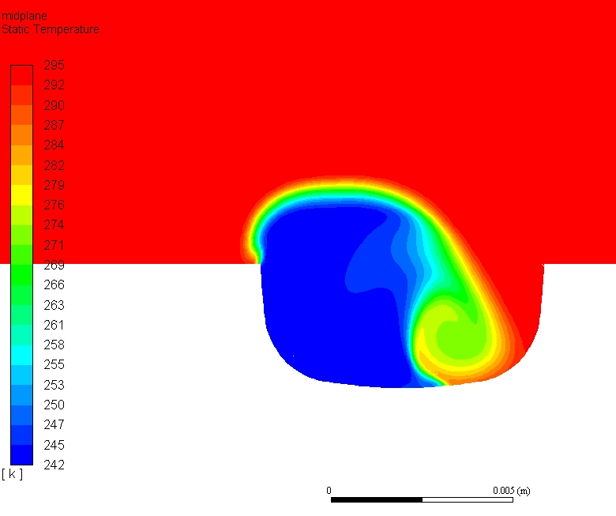
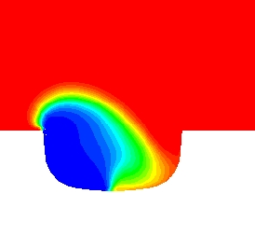
k-ω SST seems to really underpredict diffusion and over-predict vortex strength
k-ω SST
Realizable k-ε
k-ω SST shows a vortex going all the way from the inlet to the exit of the hole generated by the sharp turn in the inlet. Diffusion seems to be minimal both in terms of velocity and temperature. Realizable k-ε does a very good job of predicting turbulence generation in sharp corners which might account for the increased diffusion.

